Slide 1

Cars4U – Our Technology Approach

Slide 2

AGENDA
The Problem Definition
Data Overview
Modeling Process
Next Steps
Appendix(s)
Notes:
We will start with our agenda – here are the topics we plan to cover today. We will start by defining what is the problem we are trying to solve as a company. After which we will discuss the approach we are taking to solving the problem – including the data we are using, the modeling process we followed, and what our next steps will be from here. At the end, I have included some additional content on our modeling process that can be viewed for reference if desired. So with that all being said – let’s dive in.

Slide 3

The Problem: We need to find our place in a growing market.
Notes:
Here are Cars4U, we are a new player to this existing market. The market is growing, and there is opportunity, but we need to find our place in it…

Slide 4

The Used Car Market is Growing
Global market size The used car market is projected to reach over $1.5 trillion in 2027, up from $1.2 trillion in 2020. This growth is due to changing car ownership patterns and the rise of online sales channels.
US market size The US used car market was valued at $191.24 billion in 2022 and is expected to reach $385.18 billion by 2032. In 2021, over 43.1 million used light vehicles were sold in the US, which was a slight increase from 2019. However, Cox Automotive estimated that used retail sales for 2023 were down about 3% from the previous year, due to a limited supply of newer used vehicles.
Used car prices As of July 2024, used car prices are falling, which is good for buyers but challenging for sellers. Consumer Reports says that higher interest rates and manufacturers' focus on new models have made used cars less affordable.
https://www.coxautoinc.com/market-insights/estimated-monthly-used-vehicle-saar-and-volume/#:~:text=A%20monthly%20post%20will%20be,54%2C000%20units%2C%20from%20December%202022.
Notes:
Here is some data from the market research we did prior to beginning our journey…. The key take-away is that this can be a profitable market segment if we can find a way to be competitive within it.

Slide 5


What about our competition?
CarGurus
Offers Unbiased Listings: CarGurus doesn’t discriminate by putting paying customers’ vehicles first. The best deals are listed at the top, followed by fair deals and then those that are priced over the Instant Market Value.
Dealer Reviews: You can read CarGurus’ reviews by other buyers which can tell you what to expect from a particular dealer.
However, “Market Value” of the cars posted are abstract calculations and frequently different than other common pricing models such as the Kelly Blue Book….
TrueCar
User-Friendly Search Tools and Vehicle Research Resources: TrueCar provides user-friendly search tools and vehicle research resources, making shopping and comparing easy
Large Dealer Network: TrueCar has a large dealer network, which expands the inventory selection – the portal aggregates data from these dealers to obtain pricing estimates for cars.
However, pricing data is based on averages of new cars and discounted for age – but there is little information on why a particular car may have the price that it does…
Notes:
Let’s take a look at who some of our top competitors will be once we launch….

Slide 6

SO how do we differentiate?
Our strategy will focus on
Data-Driven insights for used-car prices and
clear presentation of the specific factors which had the greatest impact on the pricing of the vehicle –
presenting accurate data to our customers and instilling trust in our platform to be their aid in their used car shopping experience.
Notes:
So the question you must be asking at this point is “How are we going to do this?” “How are we going to differentiate ourselves?” Our strategy will focus on…

Slide 7
Data Overview
The building blocks of our platform
Notes:
So, next – let’s take a look at the data. What have we been building with.

Slide 8
Our Data
Data Dictionary
S.No.: Serial Number
Name: Name of the car which includes Brand name and Model name
Location: The location in which the car is being sold or is available for purchase (Cities)
Year: Manufacturing year of the car
Kilometers_driven: The total kilometers driven in the car by the previous owner(s) in KM
Fuel_Type: The type of fuel used by the car (Petrol, Diesel, Electric, CNG, LPG)
Transmission: The type of transmission used by the car (Automatic / Manual)
Owner: The number of previous owners.
Mileage: The standard mileage offered by the car company in kmpl or km/kg
Engine: The displacement volume of the engine in CC
Power: The maximum power of the engine in bhp
Seats: The number of seats in the car
New_Price: The price of a new car of the same model in INR 100,000
Price: The price of the used car in INR 100,000 (Target Variable)
 | S.No. | Year | Kilometers_Driven | Mileage | Engine | Power | Seats | New_price | Price
Count | 7253.00 | 7253.00 | 7.25 | 7251.00 | 7207.00 | 7078.00 | 7200.00 | 10006.00 | 6019.00
Mean | 3626.00 | 2013.00 | 5.87 | 18.14 | 1616.57 | 112.77 | 5.28 | 22.78 | 9.48
Std. | 2093.00 | 3.25 | 8.44 | 4.52 | 595.29 | 53.49 | 0.81 | 27.76 | 11.19
Min | 0.00 | 1996.00 | 1.71 | 0.00 | 72.00 | 34.20 | 2.00 | 3.91 | 0.44
25% | 1813.00 | 2011.00 | 3.40 | 15.17 | 1198.00 | 75.00 | 5.00 | 7.89 | 3.50
50% | 3626.00 | 2014.00 | 5.34 | 18.16 | 1493.00 | 94.00 | 5.00 | 11.57 | 5.64
75% | 5439.00 | 2016.00 | 7.30 | 21.10 | 1968.00 | 138.10 | 5.00 | 26.04 | 9.95
Max | 7252.00 | 2019.00 | 6.50 | 33.54 | 5998.00 | 616.00 | 10.00 | 375.00 | 160.00
Notes:
The data store that we have includes used car pricing data from 1996 up to 2019. We have roughly 7200 unique records that we can use for our analysis and designing of prediction models. The key data points we have to work with are….

Slide 9
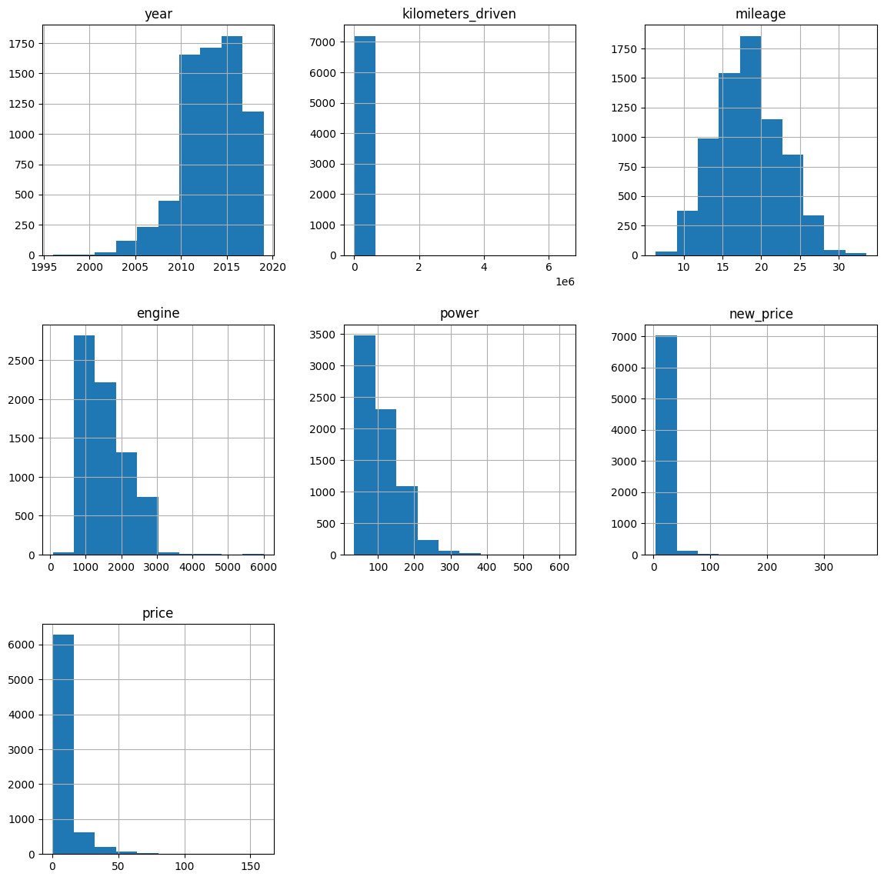
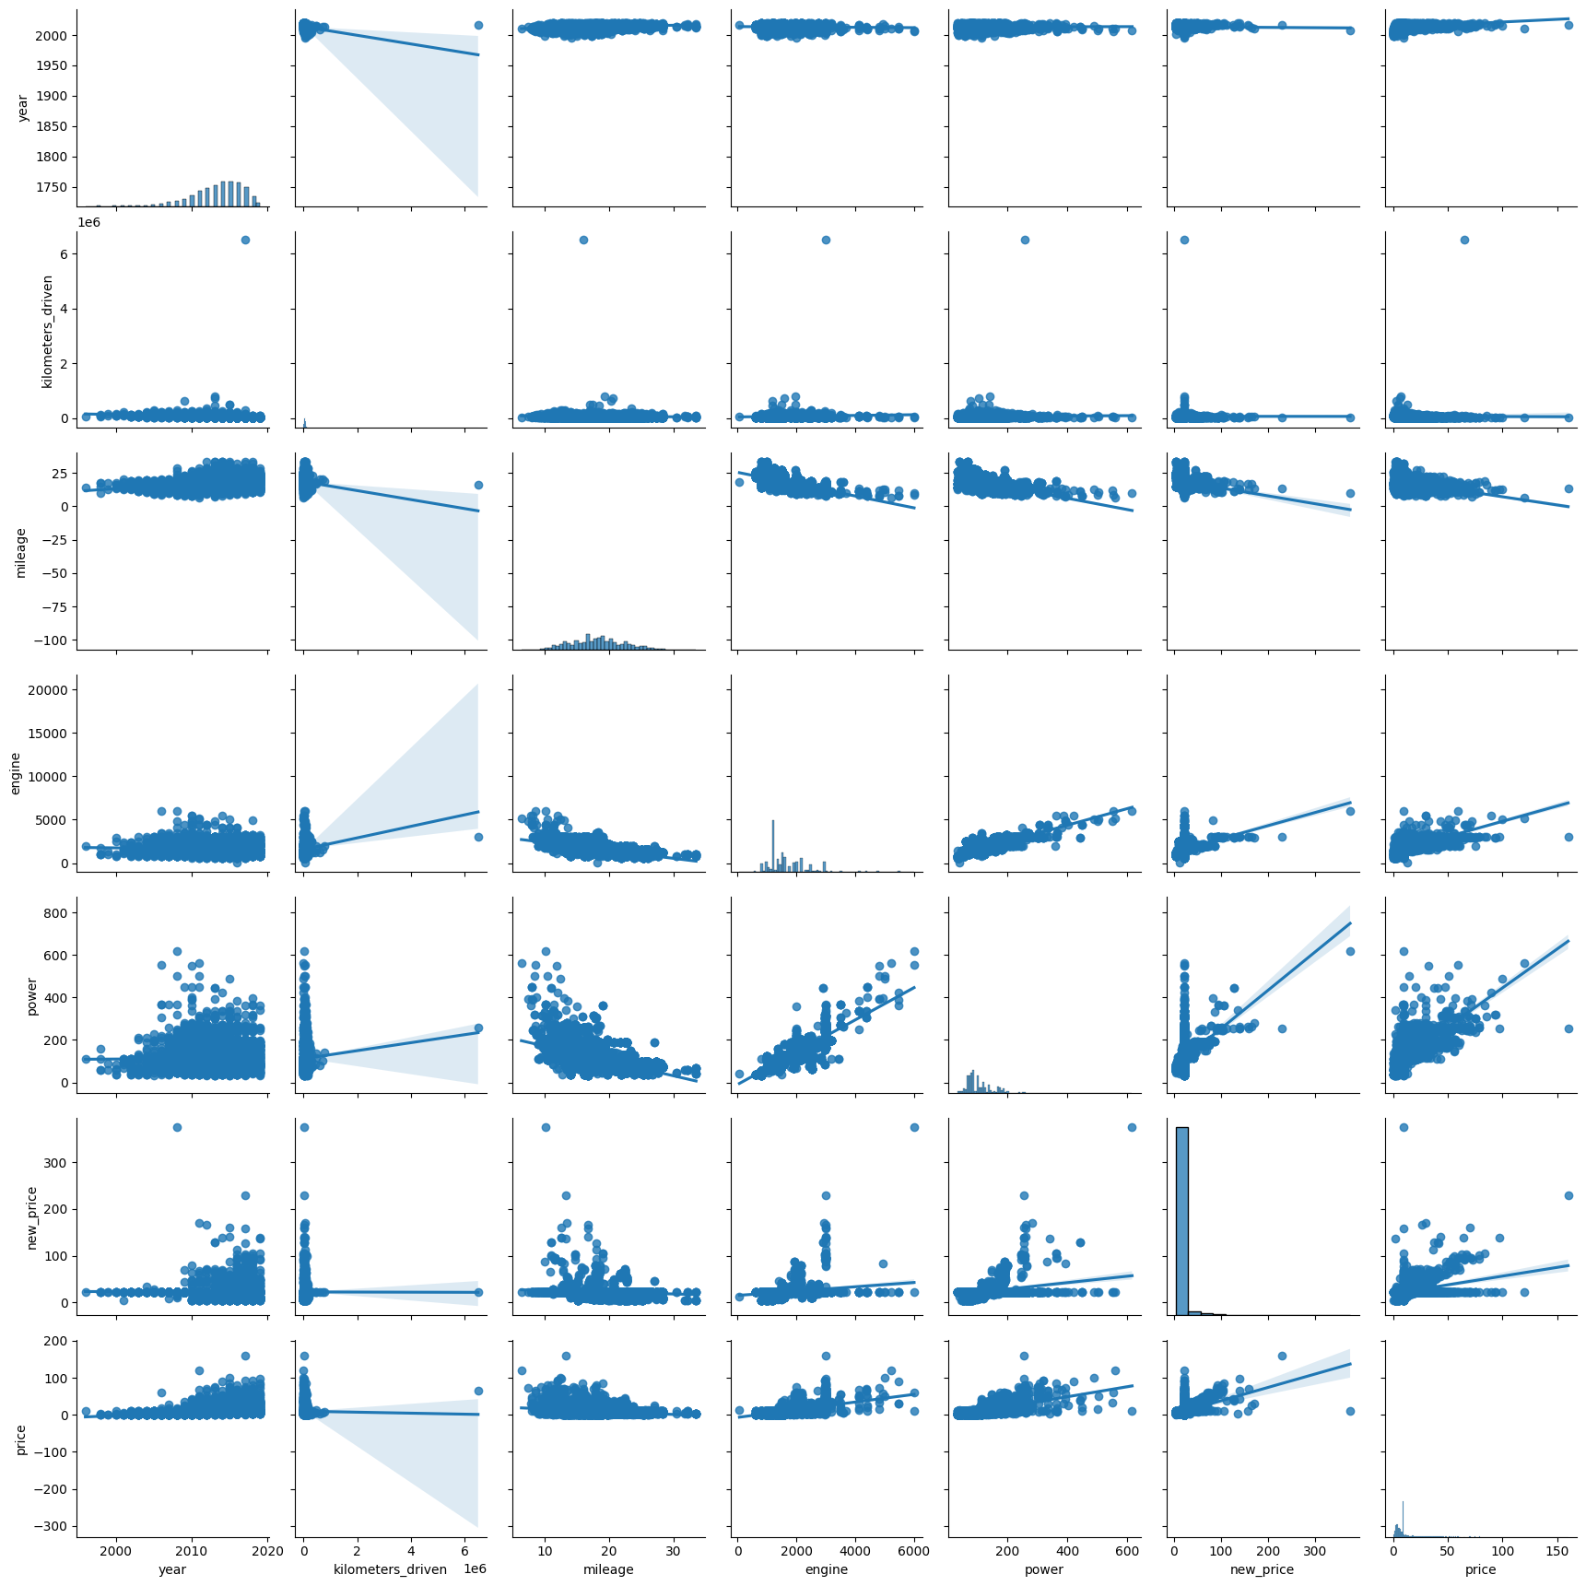
Univariate and Bivariate analysis
Notes:
We started with some basics of univariate and bivariate analysis - these are just showing some of the trends and distrobutions of the data – but more are available in the appendix or the attached Jupyter Notebook upon request.

Slide 10

Data Scrubbing & Cleanup
The following Data Scrubbing, Analytics, and Cleanup tasks were performed:
Dropped Rows where # of Seats was unknown (8 rows).
Performed Mean Imputation on other rows with empty data
Performed Mean Imputation on unrealistic Mileage (fuel economy) values
Log Transformation on Kilometers_Driven, Price, New_Price to normalize skewness.
Separated vehicle names into two new columns – Brand & Name
Used One-Hot encoding to convert categorical variables for use in modeling
Notes:
The analysis and data exploration we performed help to inform multiple things about the data and uncovered some data scrubbing and cleanup that was required before we could proceed to modeling. There were 8 rows of data where the number of seats in the vehicle was unknown. Because this was a relatively very low amount of data, we opted to simply drop those rows from the dataset prior to beginning our modeling. On any other rows with missing data (for example on features such as “mileage", "engine", "power", "new_price", "price“) we opted to perform a mean imputation strategy to address the missing data. The distributions we had taken during the analysis revealed multiple features with significant skewing which we normalized using log transformations. We separated out vehicle names into two new columns and used one-hot encoding to convert categorical variables (such as the brand or the location) into a format that could be used in a regression analysis.

Slide 11
Modeling Process
Building Accurate Models for our Customers
Notes:
After doing the data cleanup, we were ready for the modeling process.

Slide 12
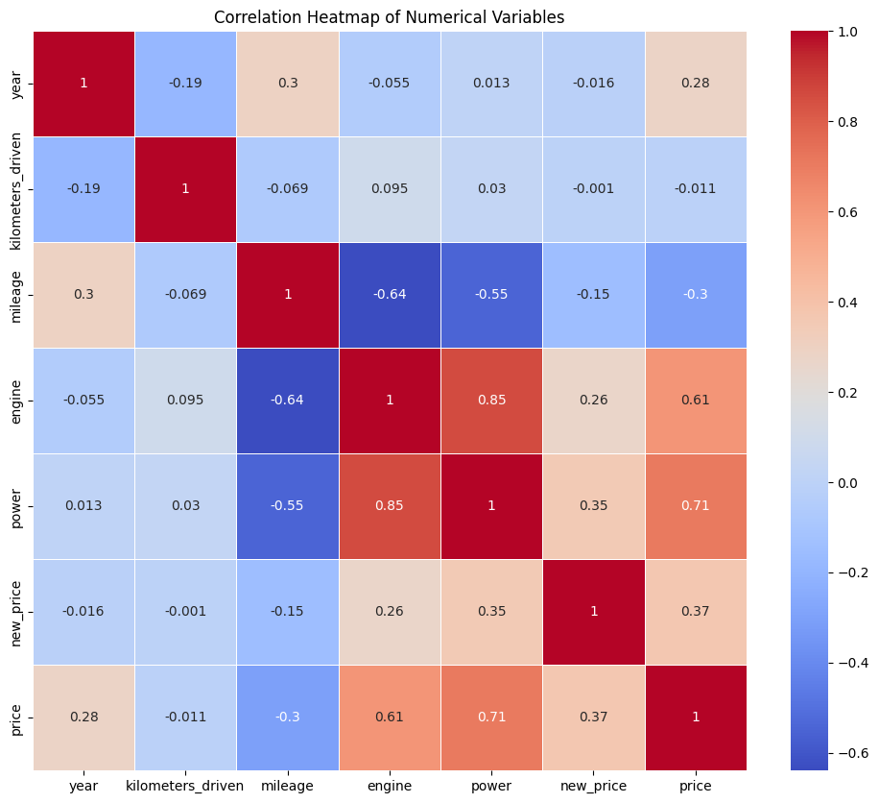
Analyzed Correlation Between Independent and Target Variables…
Correlation between price and other variables:
year: 0.280
kilometers_driven: -0.011
mileage: -0.304
engine: 0.606
power: 0.706
new_price: 0.367
Potential multicollinearity issues:
High correlation (0.85) between 'engine' and 'power' - potential multicollinearity issue.
Other statistical observations:
Highest positive correlation with price: 0.706 (power)
Highest negative correlation with price: -0.011 (kilometers_driven)
Variables with near-zero correlation with price: kilometers_driven
Notes:
We began by analyzing some correlations between our target variable (the price of the vehicle) and the other factors in our data. This helped us to observe for potential multi-collinearity and look for patterns in the data we would later choose to reflect in our model.

Slide 13
Started with Standard Linear & OLS Regression Models…
OLS Regression Results
============================================================
Dep. Variable: | price_log R-squared: 0.750
Model: OLS | Adj. R-squared: 0.747
Method: | Least Squares F-statistic: 276.7
Date: Tue, 06 Aug 2024 | Prob (F-statistic): 0.00
Time: 07:06:04 | Log-Likelihood: -1773.9
No. Observations: 5040 | AIC: 3658.
Df Residuals: 4985 | BIC: 4017.
Df Model: 54 | Covariance Type: nonrobust
Notes:
We began with a standard linear regression model after separating our data into a 70/30 split of training and testing data. The key metrics we used to evaluate the model performance were the “R2” and the “RMSE”.

Slide 14
Proceeded to Perform Additional Regression Models
Based on the table comparing the performance of the five models, the OLS (Ordinary Least Squares) model appears to be performing relatively better than the other models. It has the highest R-squared score of 0.748 and the lowest Root Mean Squared Error (RMSE) of 0.37707235524876515.
The high R-squared score indicates that the OLS model explains a significant portion of the variance in the target variable (used car prices), while the low RMSE suggests that the model's predictions have a relatively small average error compared to the actual values.
While the Random Forest model comes close in performance to the Ridge Regression model, neither surpasses the OLS model's performance in terms of both R-squared and RMSE.
However, there is still scope for further improvement in the model's performance. Even though the OLS model has the best performance among the five models, its R-squared score of 0.748 indicates that there is still some unexplained variance in the target variable that could potentially be captured by exploring additional features or using more advanced modeling techniques.
Metric | Linear Regression (standard) | OLS | Ridge | Decision Tree | Random Forest
R-squared Score | 0.684112 | 0.748000 | 0.701062 | 0.550653 | 0.698109
Root Mean Squared Error | 5.992148 | 0.377072 | 5.829170 | 7.146717 | 5.857886
In total, five (5) different modeling techniques were tested to find the most accurate approach for our customers…
Notes:
We followed a cyclical approach of building a model and evaluating its’ performance before comparing it to the next models. We built 5 models in all and observed that the best performing model was the version we built using the Ordinary Least Squares method. The high R-Squared score observed on that model indicates that the model explains a large portion of the variance in the target variable (the vehicle price) – i.e. it is accurate in predicting changes in the vehicle price. While the lowest relative RMSE compared to the other models indicates that it is the most precise model compared to the rest. We do still believe that there is additional scope for improvement, however as the R2 indicates only a 74% of the used car pricing data is accurately predicted using the given model - We would like to get this closer to 90% in order to differentiate our approach from other competitors in this space.

Slide 15
Key Features
Other Notes: Using the table of model coefficients and p-values that were derived using the best-performing OLS model, we can derive several meaningful insights about car pricing….
Positive Influences on Price:
new_price: The coefficient is positive (1.335037e-03) with a very small p-value (2.427166e-02), indicating that higher original prices correlate with higher used car prices.
engine: A positive coefficient (1.670184e-04) and a very small p-value (1.191925e-10) suggest that cars with more powerful engines tend to have higher prices.
power: This also has a positive impact (2.955084e-05) with a very significant p-value (4.993497e-28), indicating that higher power ratings contribute to higher prices.
location_Bangalore: A positive coefficient (6.901798e-02) with a relatively small p-value (3.149623e-02) suggests that cars in Bangalore may be priced higher than in other locations.
Negative Influences on Price:
mileage: A negative coefficient (-1.425920e-02) and a very significant p-value (9.349975e-10) indicate that higher mileage decreases the car price.
kilometers_driven_log: A negative coefficient (-4.980287e-02) and a significant p-value (8.189808e-08) also suggest that more kilometers driven lowers the car price.
transmission_Manual: This feature has a negative coefficient (-8.587928e-02) with a very small p-value (1.754207e-07), indicating that manual transmissions are associated with lower prices compared to automatic transmissions.
owner_type_Second and owner_type_Third: Both have negative coefficients (-4.368074e-02 and -1.040836e-01 respectively) and significant p-values (2.869216e-03 and 5.868476e-03), suggesting that cars with multiple previous owners are priced lower.
We will use this data to present our pricing to our customers and instill TRUST in our platform…
Notes:
Some other key notes from the modeling process are WHICH FEATURES had the greatest impact on our prediction of the price… We plan to use this data to show our customers how our pricing metrics are generated and instill their trust in our platform.

Slide 16
Next Steps
Integrating our Models into our Website
Notes:
Let’s take a couple of minutes to talk about next steps. Now that we have this model, what do we do next?

Slide 17
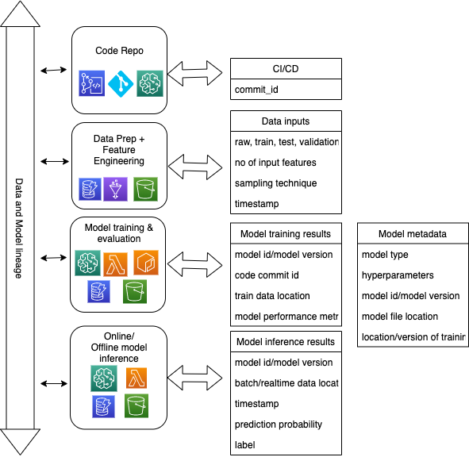
Key Features
After successfully developing the initial draft of our machine learning model for predicting used car prices, we are poised to take a significant leap forward in our project. The next phase involves productization of the model, a critical step where we transition from a prototype to a fully operational service. To achieve this, we will be integrating our model with AWS SageMaker, a robust and scalable platform that will not only streamline deployment but also facilitate the management of our machine learning lifecycle.
By leveraging SageMaker’s capabilities, we will expose a predictions API that will seamlessly integrate with our website. This will allow our customers to obtain real-time, accurate price predictions for used cars, enhancing their user experience and our platform’s value proposition.
Furthermore, we recognize that our current model, as it stands, is a starting point. Machine learning models thrive on continuous learning and improvement. Therefore, we will utilize SageMaker’s powerful experimentation and tracking features to conduct further training and enhancements to improve our model over time.
As we progress, we will maintain a keen focus on tracking the model’s evolution over time. SageMaker’s robust versioning and tracking systems will enable us to monitor improvements and regressions, ensuring that only the best-performing models are deployed. We plan to release new and improved versions of our model to our website periodically, aligning with our commitment to deliver excellence and drive innovation in the used car market.
Notes:
Our immediate next plan of action is to begin the integration of the machine learning model into our technology platform. We will do this by using AWS SageMaker to productionlize our model and expose a Prediction REST API endpoint that can be consumed by both our website and mobile applications. In parallel – we plan to have our data scientists continue to experimenting on the data and iterating on the model – perhaps testing a Neural Network based approach next or building individual models for each specific state in which we plan to do business to see if regionality is affecting the results of the model… AWS SageMaker’s built in versioning and tracking system will be used so that we can track these experiments and progressively release and test different versions of our models on the platform.

Slide 18
Risks and Challenges
Risks and Challenges:
Market Competition: The online used car market is a “Red Ocean” environment, with established players already having a strong foothold.
Data Security: Protecting sensitive customer data and transaction details is paramount.
Technology Scalability: Ensuring the platform can handle increased traffic and data volume as the business grows.
User Trust: Building trust with users in terms of fair pricing, car condition, and transaction security.
Model Accuracy: Developing a machine learning model that accurately predicts car prices and provides value to users.
Addressing Challenges with Scientific Approaches:
Data-Driven Design: Utilize A/B testing and user feedback to iteratively improve the website’s user interface and user experience.
Scalable Architecture: Design the technology stack to be scalable using cloud services and microservices architecture.
Transparency: Foster user trust by being transparent about pricing algorithms and providing detailed car histories.
Continuous Model Improvement: Apply scientific methods such as hypothesis testing and experimental design to refine the machine learning model. Use techniques like cross-validation and feature engineering to enhance model performance.
Red Ocean Strategy vs Blue Ocean Strategy I Learn the Difference
Notes:
What are some of the outstanding risks and challenges we face? We plan to address these using the scientific method.

Slide 19

THANK YOU
Elijah Weber
Vice President Platform Solutions Architecture
Notes:
Thank you for your time!

Slide 20
Appendix 1

Slide 21
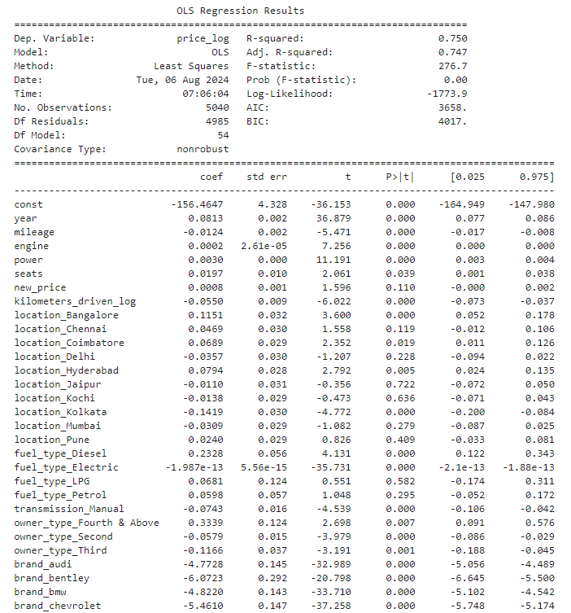
OLS Model Results
Notes:
[1] Standard Errors assume that the covariance matrix of the errors is correctly specified.
[2] The smallest eigenvalue is 3.37e-22. This might indicate that there are
strong multicollinearity problems or that the design matrix is singular.
Most overall significant categorical varaibles of LINEAR REGRESSION are :
['seats', 'location', 'owner_type', 'fuel_type', 'transmission', 'mileage', 'kilometers_driven', 'kilometers_driven_log', 'engine', 'brand', 'power', 'year']
Notes:
Our immediate next plan of action is to begin the integration of the machine learning model into our technology platform. We will do this by using AWS SageMaker to productionlize our model and expose a Prediction REST API endpoint that can be consumed by both our website and mobile applications. In parallel – we plan to have our data scientists continue to experimenting on the data and iterating on the model – perhaps testing a Neural Network based approach next or building individual models for each specific state in which we plan to do business to see if regionality is affecting the results of the model… AWS SageMaker’s built in versioning and tracking system will be used so that we can track these experiments and progressively release and test different versions of our models on the platform.

Slide 22
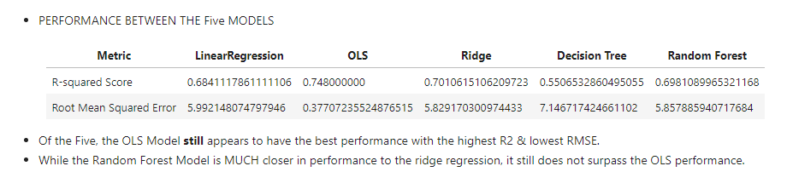
Model Comparison

